Slide 1

STUDENT ENROLLMENT
ANALYSIS SYSTEM (SEAS)

Slide 2






CSE303- Sec-04- Group-05
1921371
1920932
1920468
1920044
1921793
1930274
ID
ID
ID
ID
ID
ID
Md. Zakaria Kabir
Sumaia Anjum Shaba
Ahad Al Tanvir Ahmed
Fayeeza Subah Islam
Nusrat Jahan
Quazi Munzur E Ellahi Ruhin

Slide 3
Rich Picture (AS-IS)

Slide 4
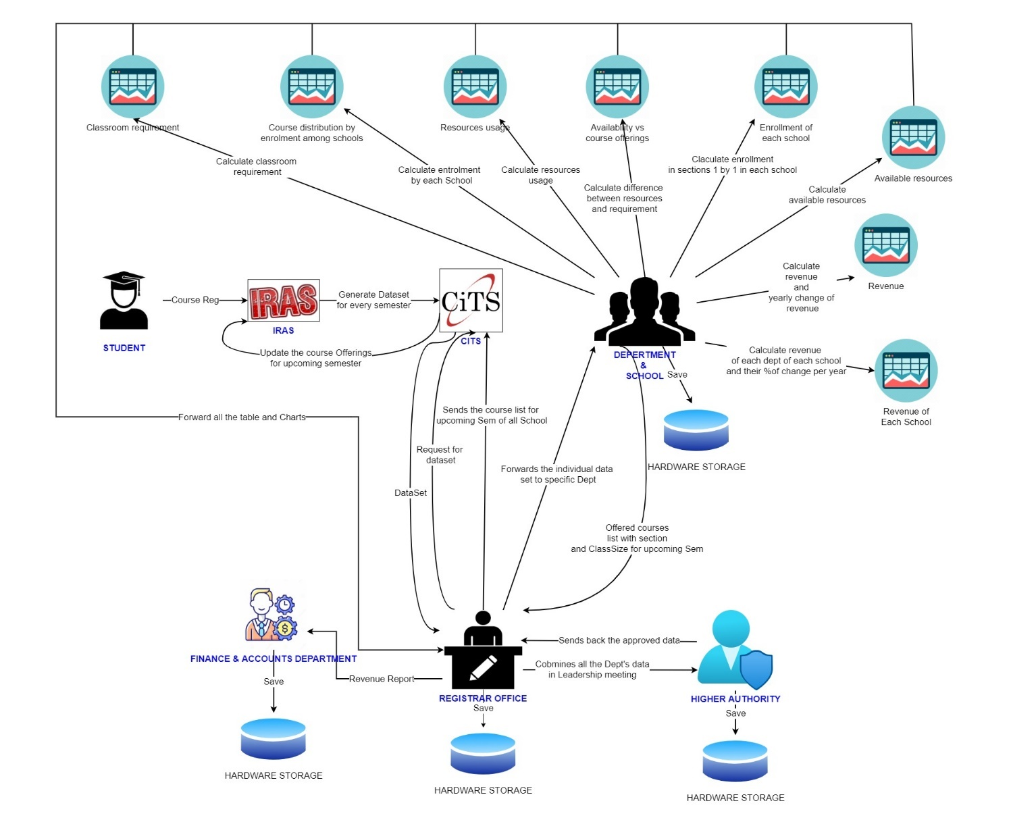

Slide 5
Six Element Analysis (AS-IS)

Slide 6
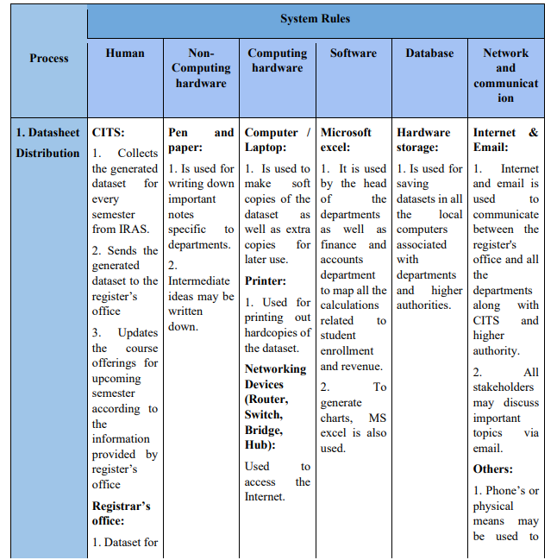

Slide 7
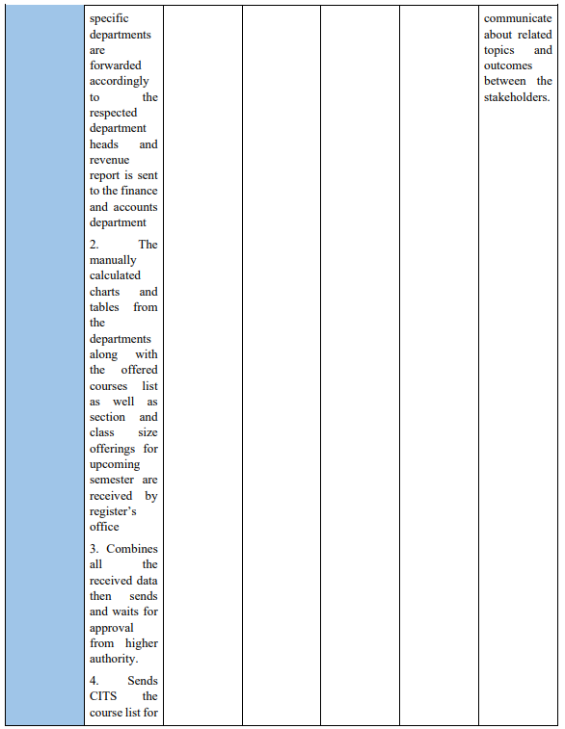

Slide 8
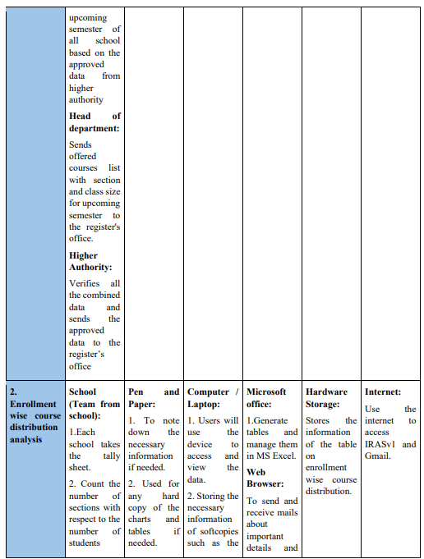

Slide 9
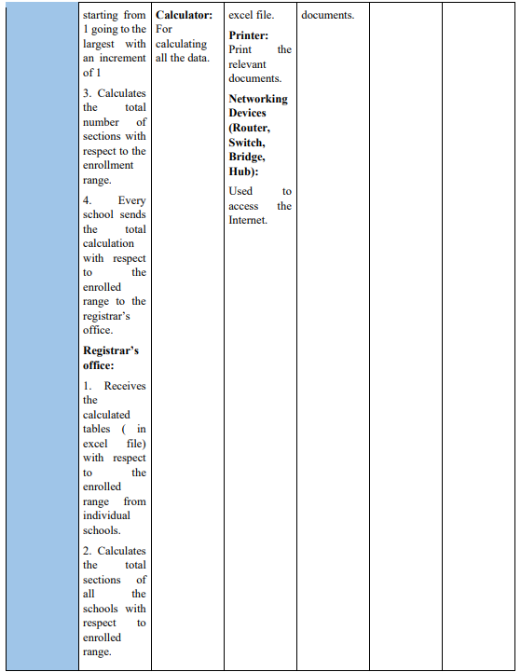

Slide 10
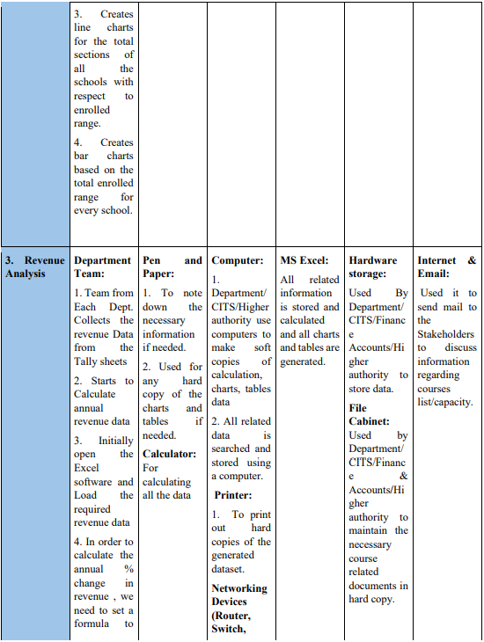

Slide 11
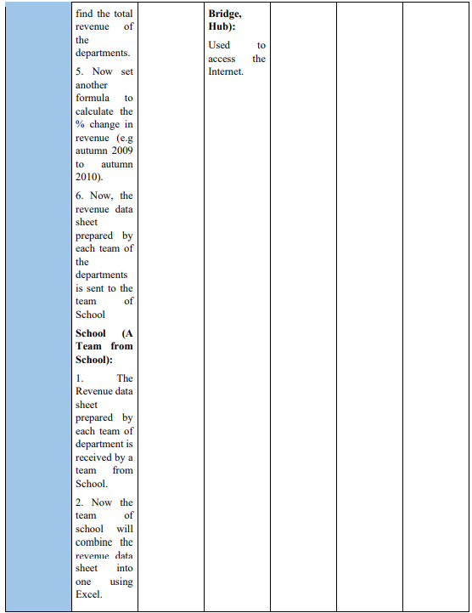

Slide 12
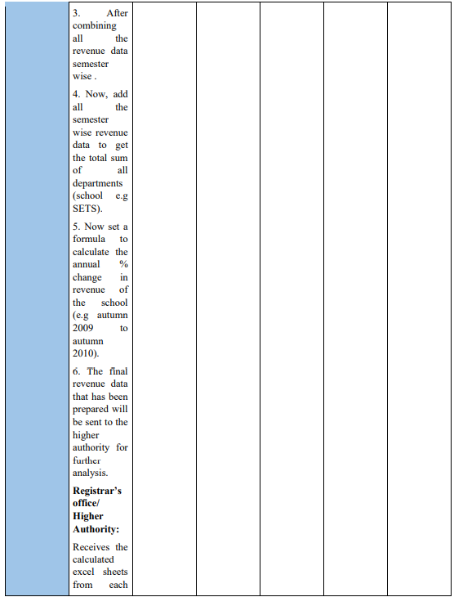

Slide 13
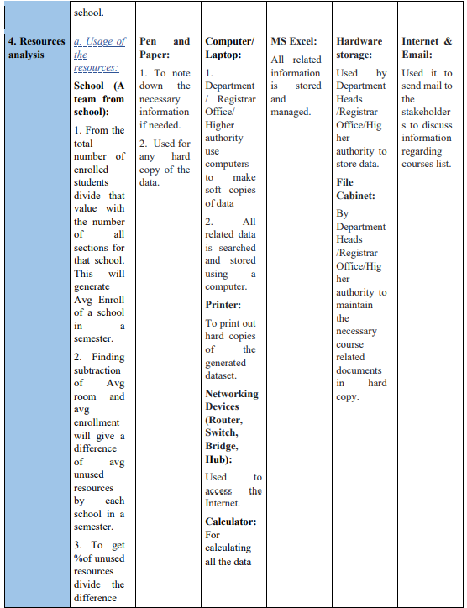

Slide 14
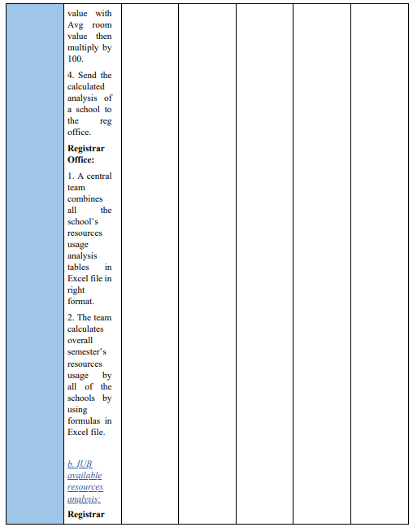

Slide 15
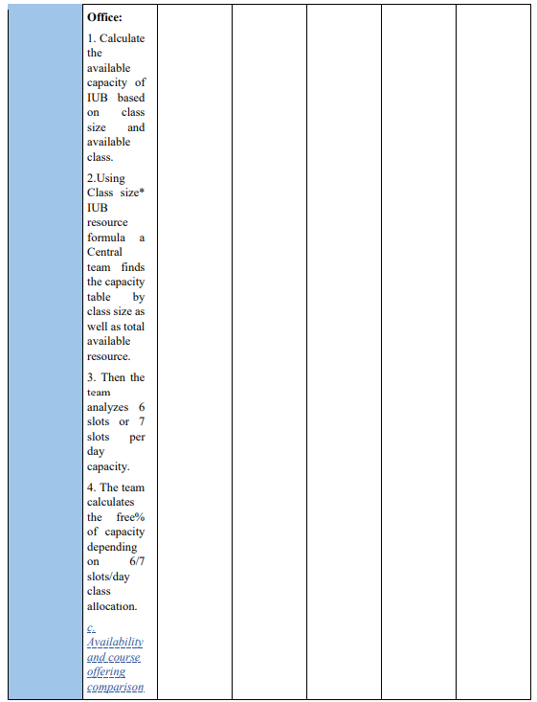

Slide 16
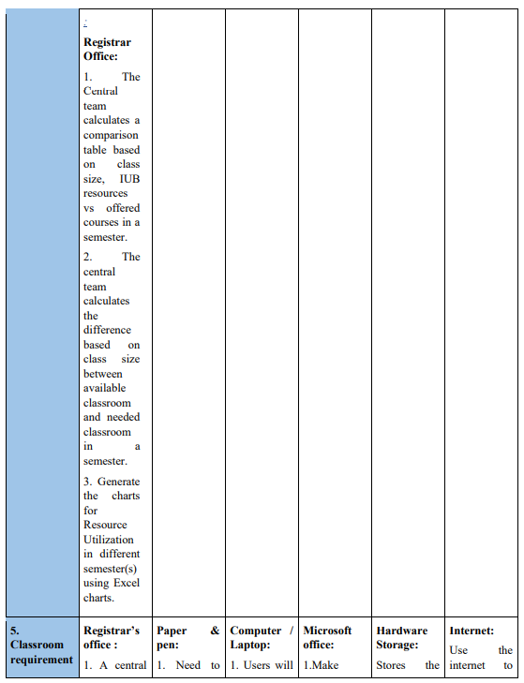

Slide 17
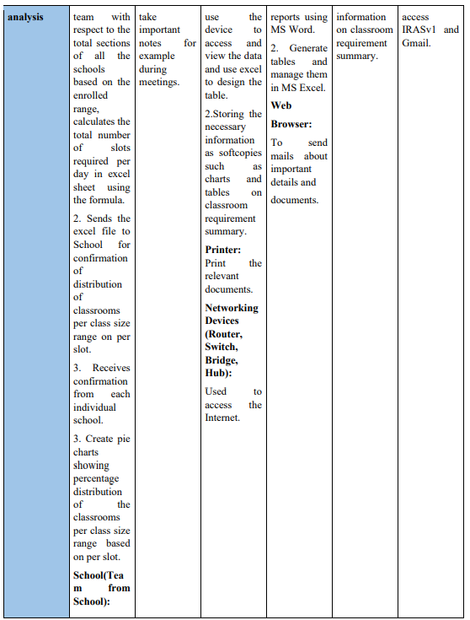

Slide 18
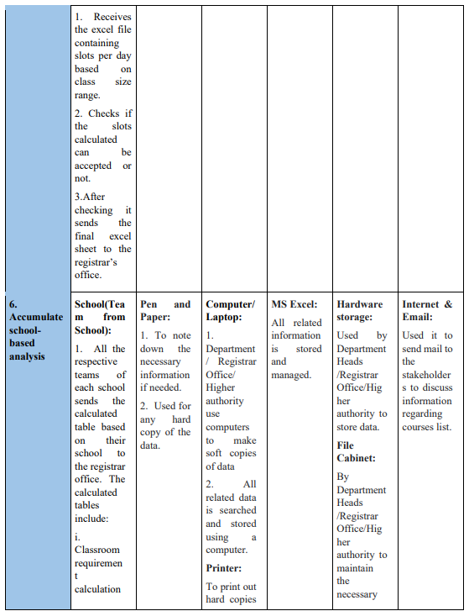

Slide 19
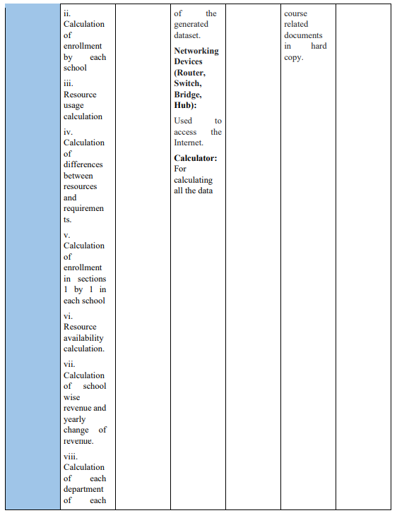

Slide 20
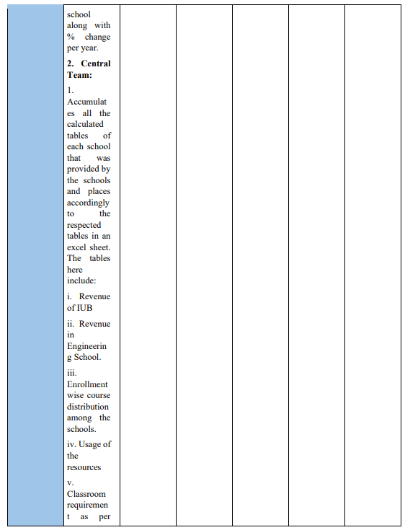

Slide 21
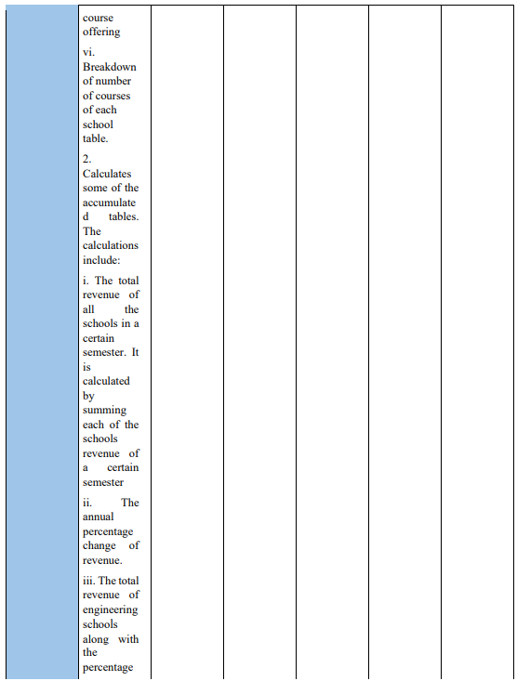

Slide 22
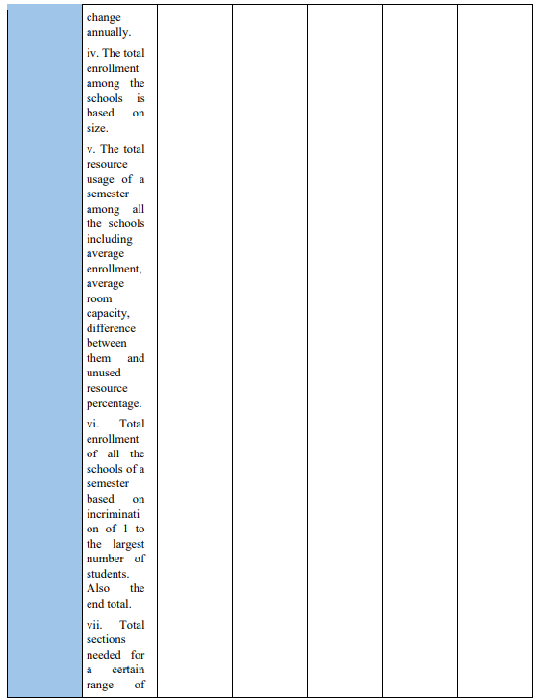

Slide 23
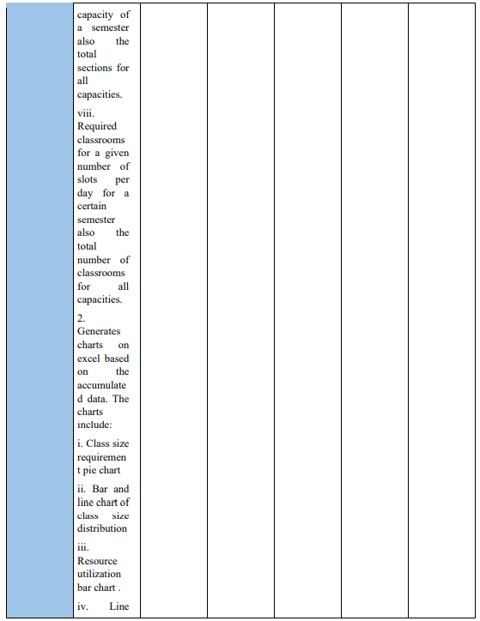

Slide 24
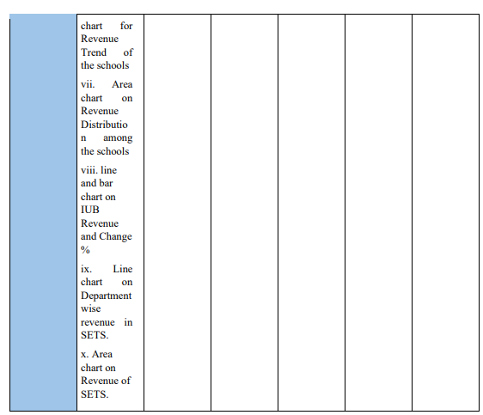

Slide 25
Process Diagram (As-Is)

Slide 26
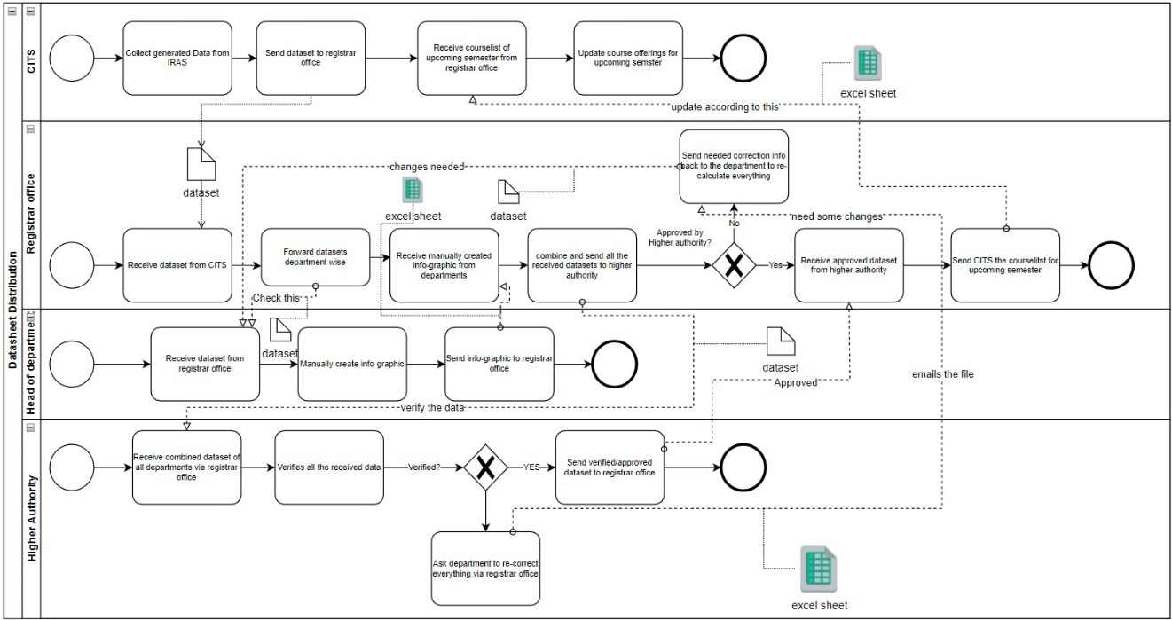

Slide 27
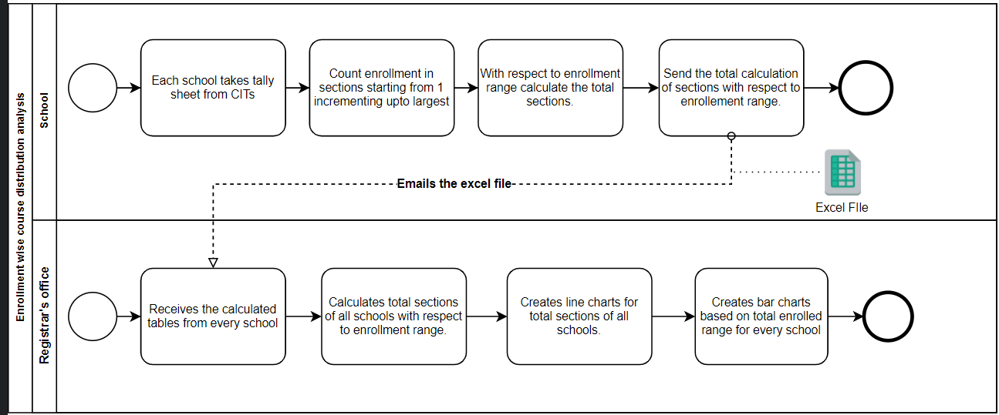

Slide 28
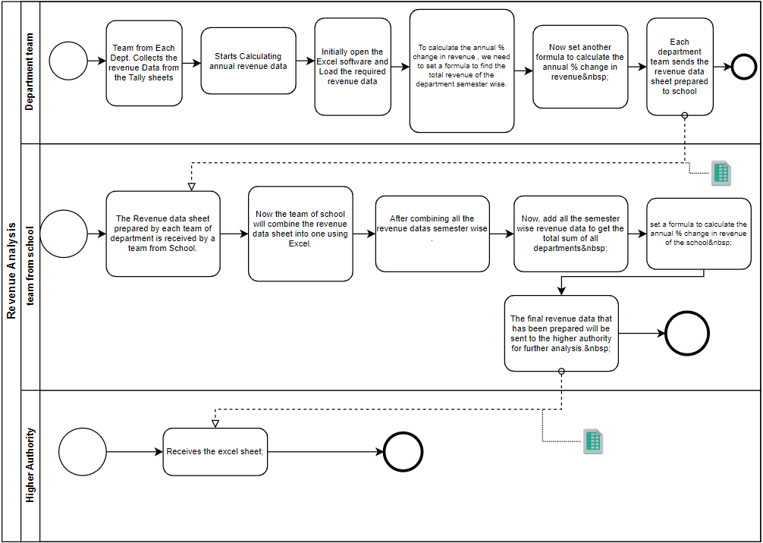

Slide 29
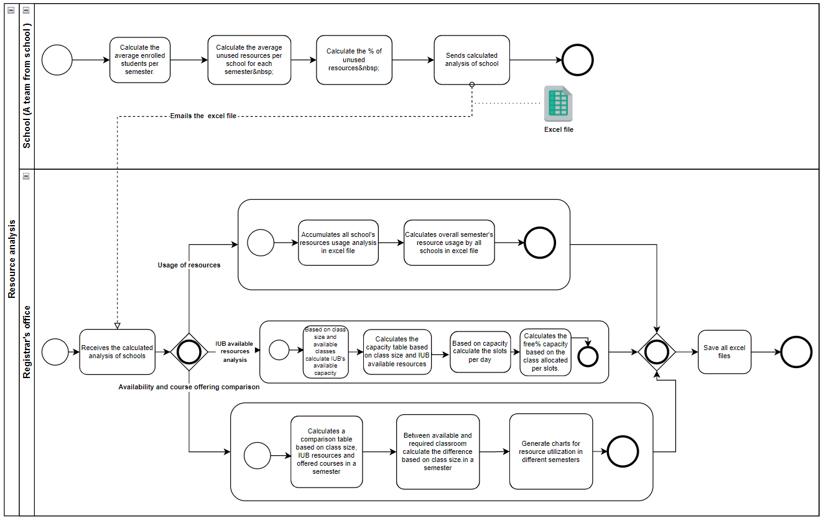

Slide 30
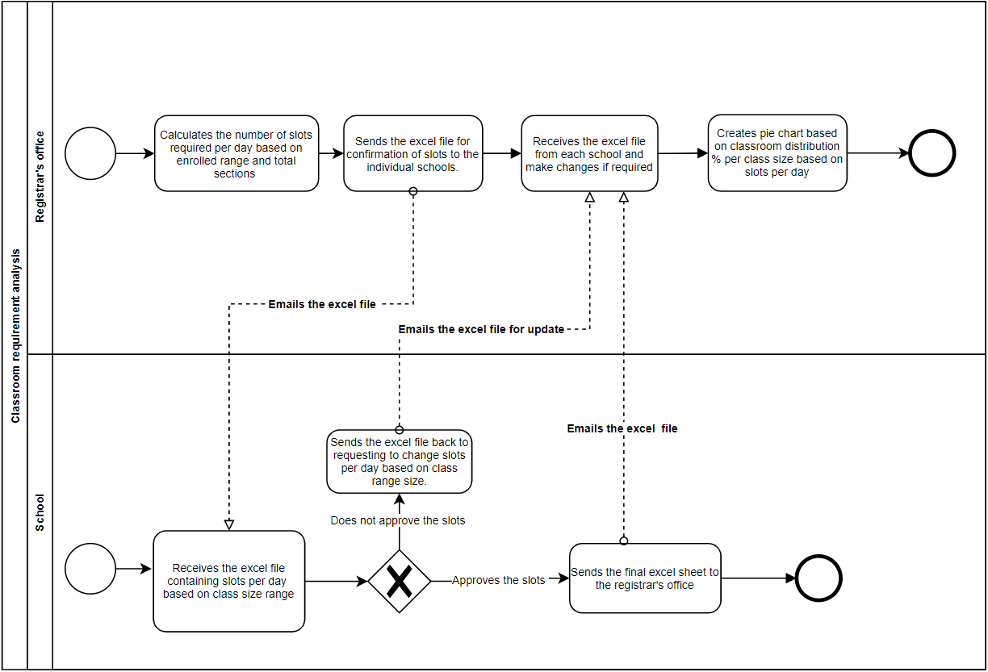

Slide 31
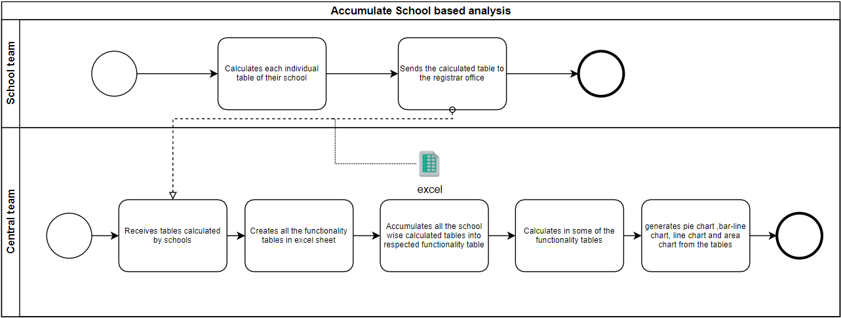

Slide 32
PROBLEM ANALYSIS – EXISTING SYSTEM

Slide 33
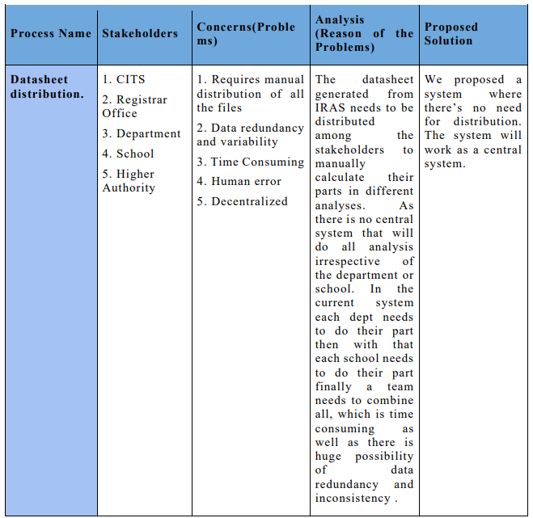

Slide 34
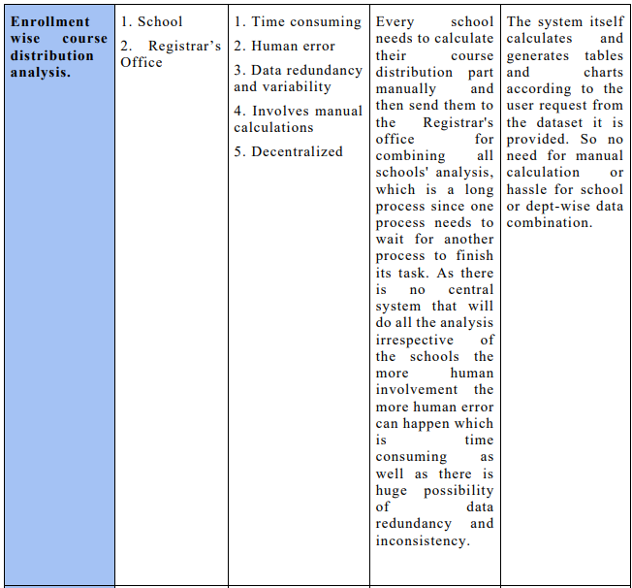

Slide 35
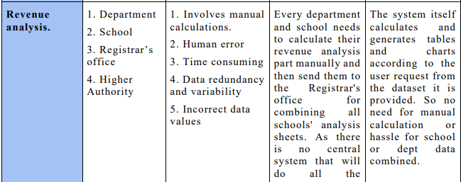
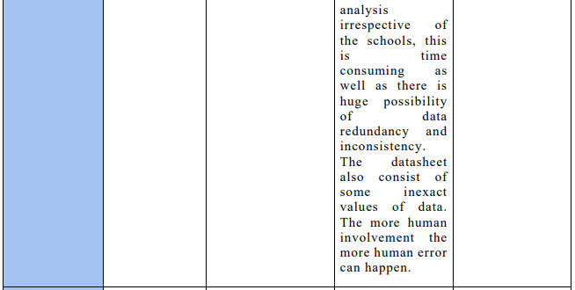

Slide 36
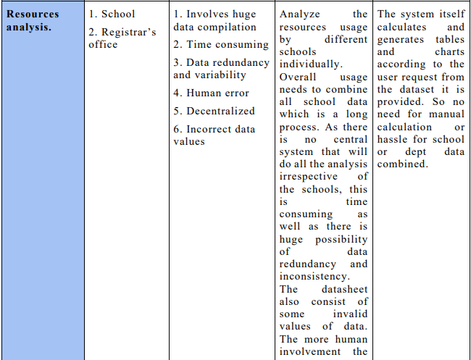

Slide 37
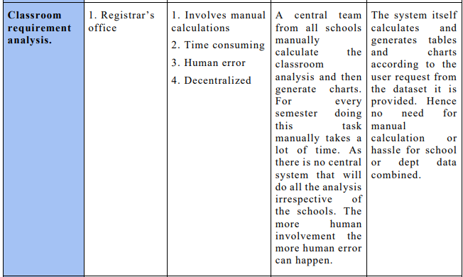

Slide 38
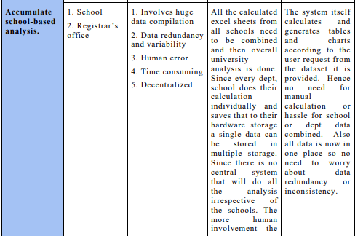
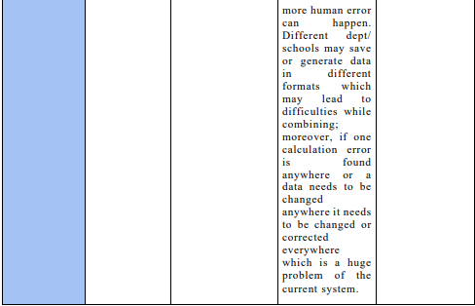

Slide 39
Rich Picture (TO-BE)

Slide 40
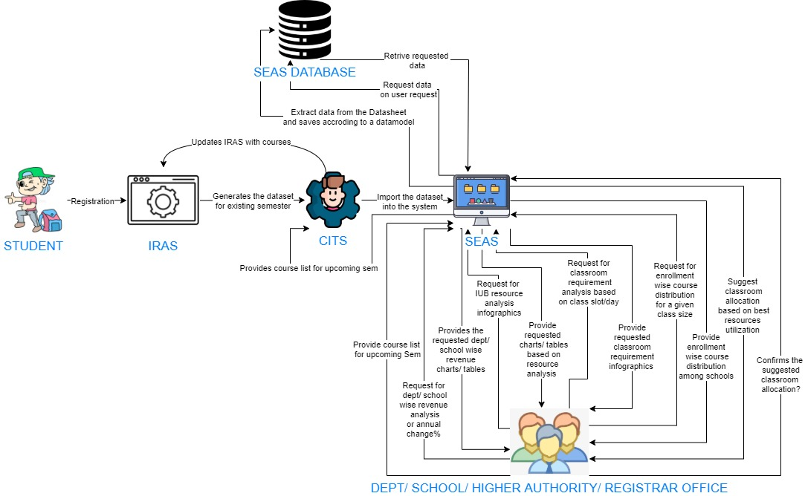

Slide 41
Six Element Analysis (TO-BE)

Slide 42
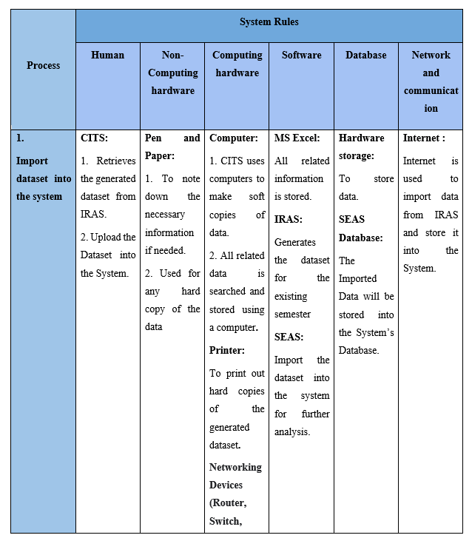

Slide 43
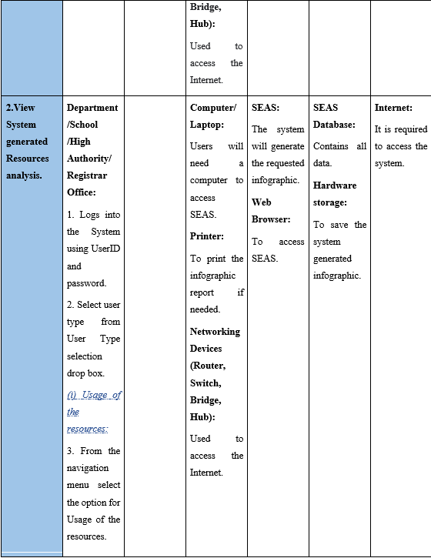

Slide 44
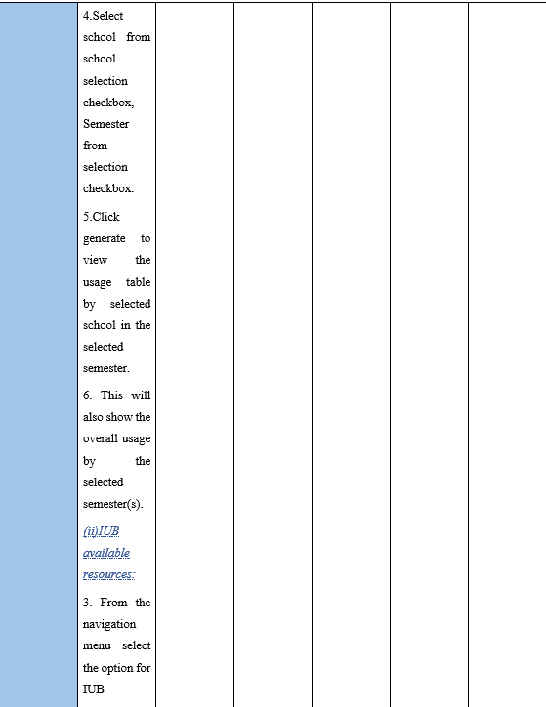

Slide 45
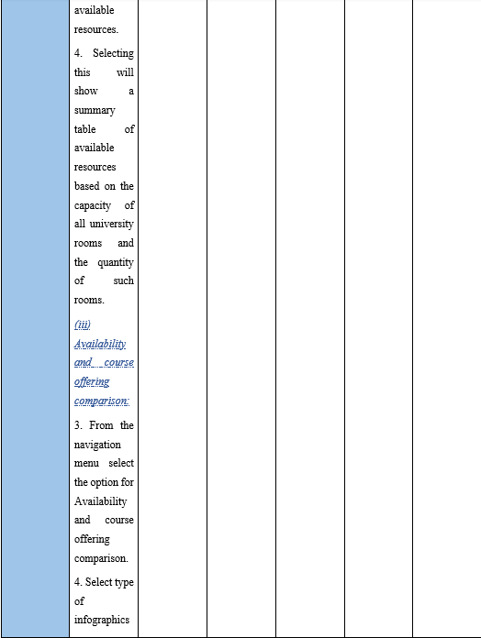

Slide 46
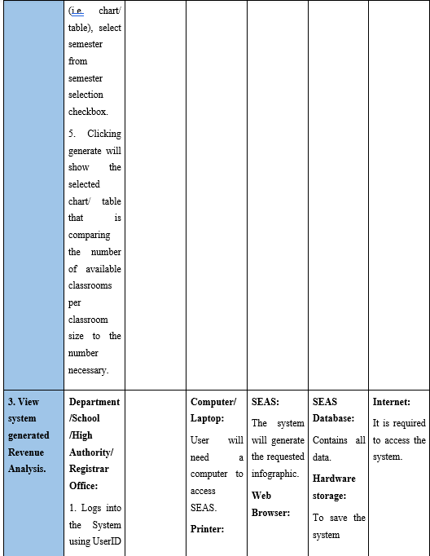

Slide 47
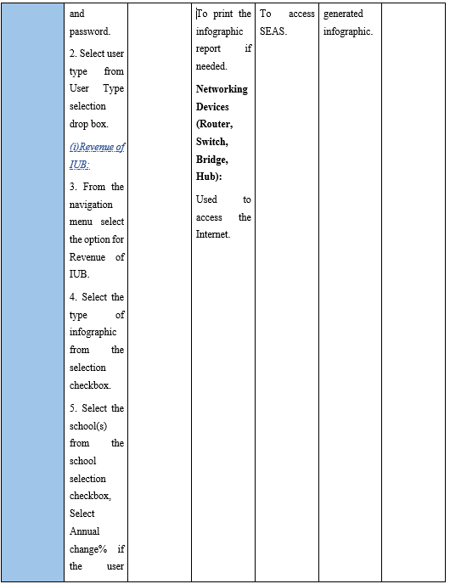

Slide 48
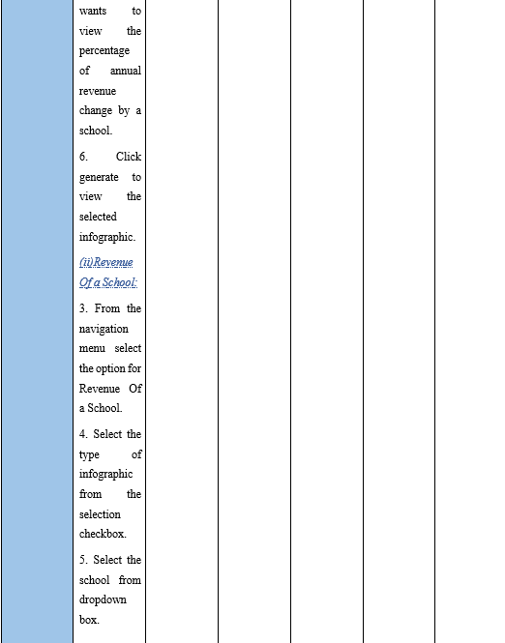

Slide 49
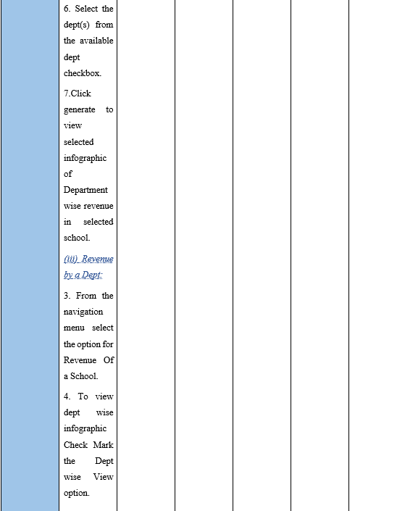

Slide 50
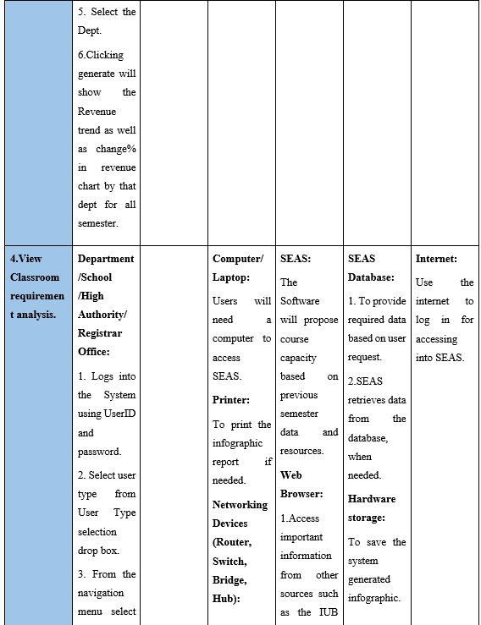

Slide 51
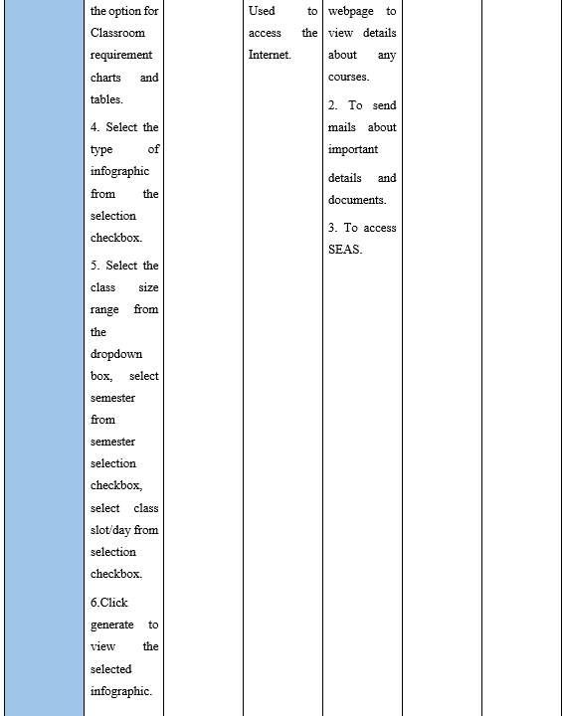

Slide 52
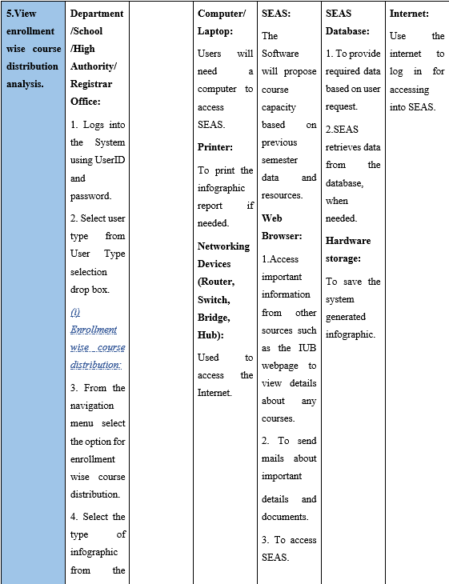

Slide 53
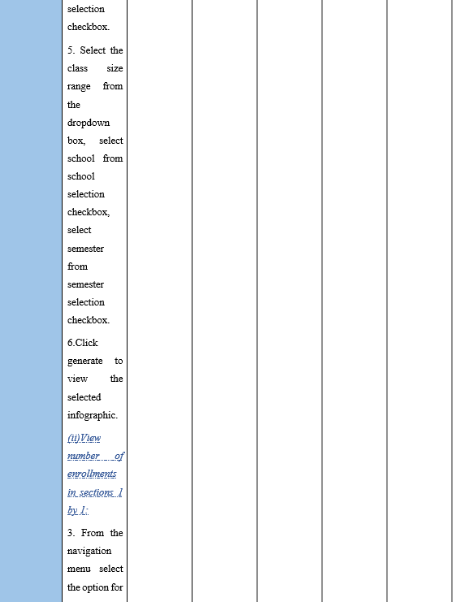

Slide 54
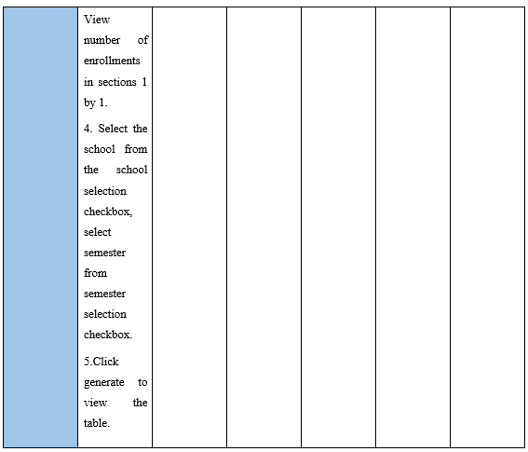

Slide 55
Process Diagram (To-be)

Slide 56
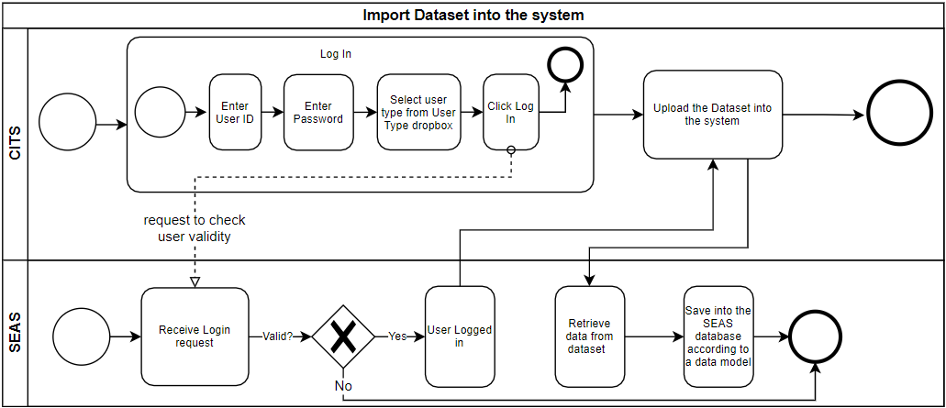

Slide 57
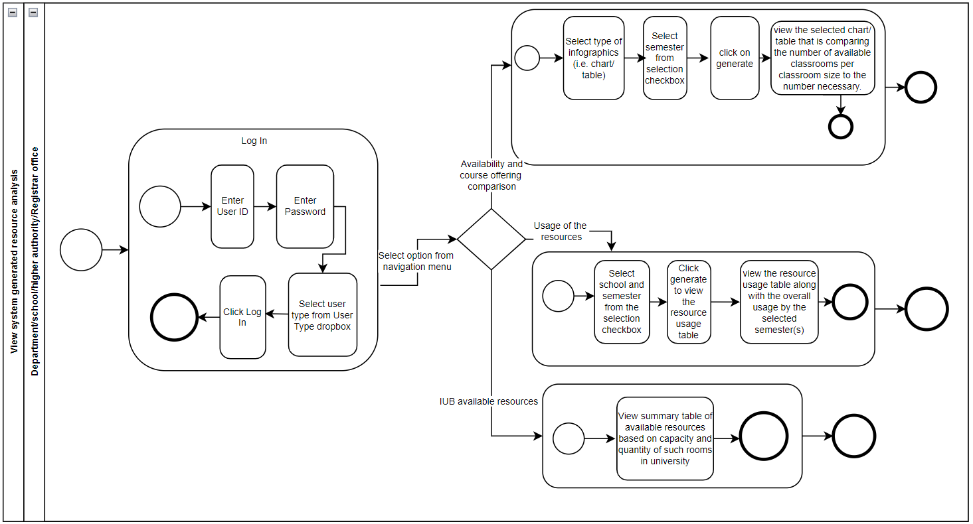

Slide 58


Slide 59


Slide 60


Slide 61
BUSINESS RULE

Slide 62


Slide 63
Entity Relationship Diagram (ERD)

Slide 64


Slide 65
Relational Schema

Slide 66


Slide 67
NORMALIZATION

Slide 68

Functional Dependency

Slide 69

1NF

Slide 70

2NF

Slide 71

3NF

Slide 72

BCNF

Slide 73
IMPLEMENTATION

Slide 74

Log in Dashboard of SEAS
Front-End Developing tools: HTML, CSS, Bootstrap JavaScript, Chart Js
Back End Developing tools: Python, Django
Database-integration: MySQL

Slide 75


Slide 76


Slide 77


Slide 78


Slide 79


Slide 80


Slide 81


Slide 82



Slide 83


Continued..

Slide 84

Continued..

Slide 85



Slide 86


Slide 87


Slide 88


Slide 89


Slide 90


Slide 91


Slide 92




Slide 93


Slide 94


Slide 95


Slide 96


Slide 97

THANK YOU

